Slide 1
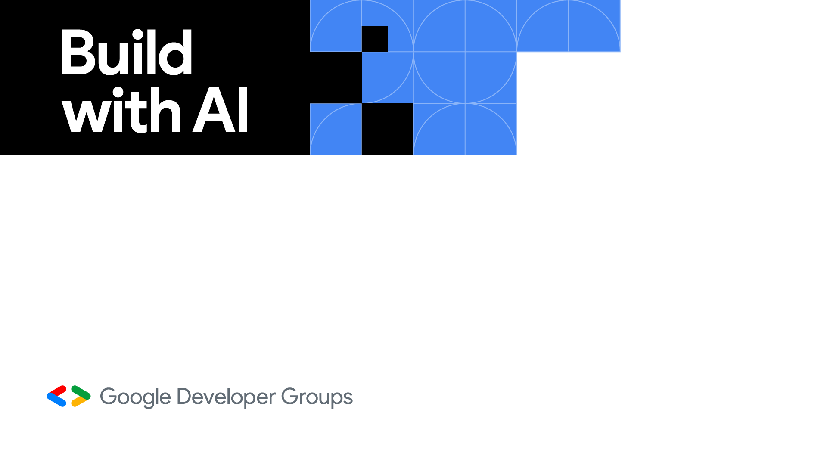
Introduction to RAG Application with GEMINI and LangChain
Anjana Kumar
Taipei

Slide 2

About Me
Hi,
I am Anjana.
I am a Data Science Engineer at Micron Technology, Taoyuan.
My Interests : AI, Deep Learning,Image Processing, NLP, Generative Models, Computer Vision
LinkedIN Profile

Slide 3
Agenda
Part 2 : Demo (1 hour and 30 minutes)
Use API key to access Gemini Models and Basic Prompting
Use LangChain frame to access Gemini models
Play with LangChain Components and Modules
Build a basic RAG application with Gemini and LangChain
Try it yourself!
Question and Answers
Part 1: Presentation (30 minutes)
Large Language Models
Gemini Model
Get Gemini API Key
What is RAG?
RAG Architecture
Applications of RAG
What is LangChain?
LangChain Components

Slide 4
Part 1 : Presentation

Slide 5
Large Language Models
The paper titled "Attention is All You Need" by Vaswani et al marked a significant breakthrough in natural language processing (NLP).
This influential work introduces the fundamental concept of Transformers, which has led to the development of various NLP models like chatGPT, BERT,Llama and many more LLMs capable of tackling a wide array of NLP tasks.

Slide 6
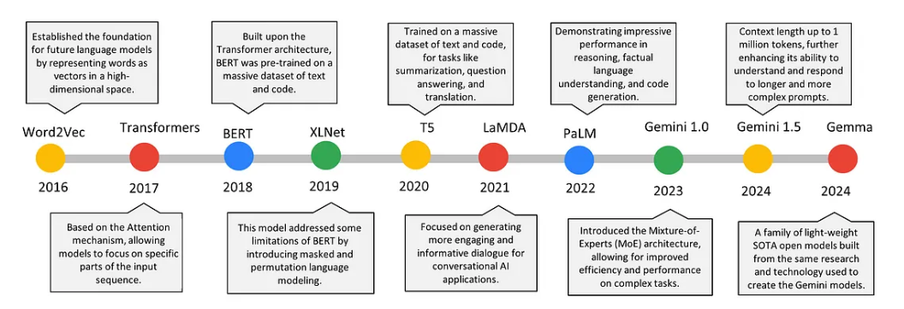
Large Language Models
Image taken from :
https://medium.com/google-developer-experts/unlock-your-ideas-with-gemini-hands-on-guide-8638b1402dd9

Slide 7
Gemini Model
Gemini, developed by Google DeepMind, comprises a family of advanced multi-modal AI models.
It relies on Transformers and Mixture of Experts (MoE) to handle wide range of tasks.
Its training dataset encompasses a wide array of sources, including text, code, images, videos, and audio.
Capable of tackling complex tasks such as summarizing extensive texts and identifying content within media files.
Gemini is adept at documenting large codebases and identifying bugs, among other functionalities.

Slide 8
Gemini Model Architecture
Output
(Summary,
Code, description of an image etc.)
Input
(Text/
Image/
codebase)
Mixture of Experts (MoE)
Encoder
Decoder

Slide 9
Mixture of Experts
Instead of relying on a single, monolithic model, MoE utilizes a network of smaller, specialized models known as "experts".
Input is directed to the most suitable expert based on its characteristics, enhancing efficiency and performance.

Slide 10
Latest Gemini Model
Gemini 1.5 Pro (Preview)
Largest model with multimodal capabilities
Input : Text / Image
Output : Text
Token Limit : 1048576
Gemini 1.0 Pro
Input : Text
Output : Text
Token Limit : 32,760
Gemini 1.0 Pro Vision
Input : Text / Image
Output : Text
Token Limit : 32,760

Slide 11
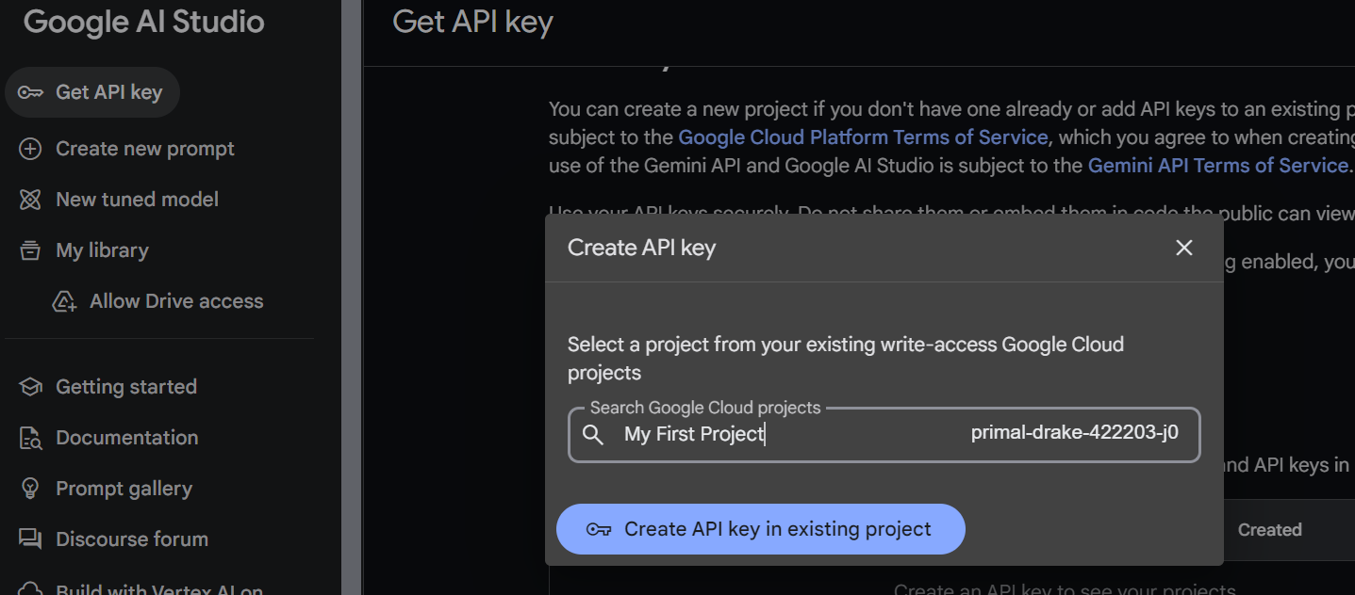
Get Gemini API Key
Go to Google AI Studio

Slide 12
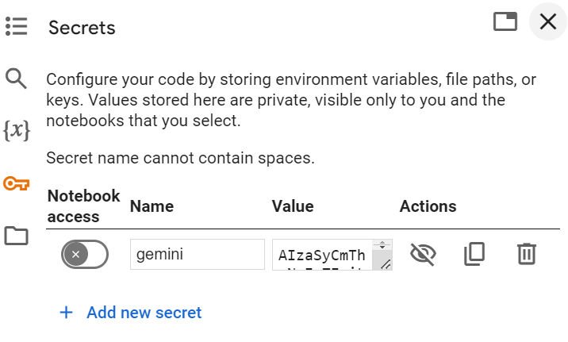
Get Gemini API Key
Save the key in Google Colab

Slide 13
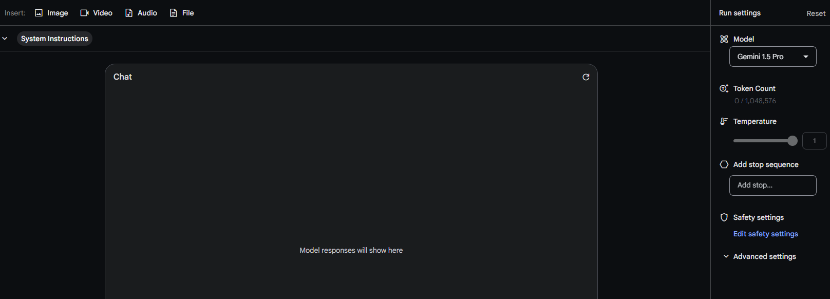
Google AI Studio
You can try out Gemini models here

Slide 14
Limitations of LLMs
Providing inaccurate information in the absence of a correct answer.
Offering outdated or generic information instead of the expected current response.
Generating responses based on non-authoritative sources.
Producing inaccuracies due to confusion in terminology, where different sources use similar terms to refer to distinct concepts.

Slide 15
Retrieval Augmented Generation
To counter these limitations of LLM, Patrick Louis with his team came up with a technique called Retrieval Augmented Generation (RAG).
Incorporates up-to-date, contextually relevant information from external sources.
AI framework enhancing response quality of Language Model Generators (LLMs).
Addresses inconsistency, lack of domain-specific knowledge in LLMs.
Reduces chances of hallucinations, incorrect responses.

Slide 16
Retrieval Augmented Generation
A RAG system consists of 2 major phases
Retrieval Phase:
Searches and retrieves relevant information for external documents provided to the LLM.
Content Generation Phase:
LLM synthesizes an answer based on retrieved information and its internal training data.Thus LLM enhances its response with the retrieved information.

Slide 17
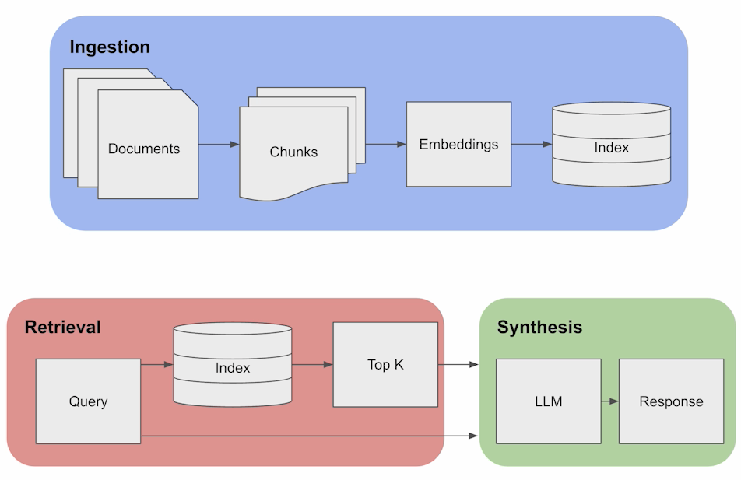
RAG Architecture
Image taken from :
https://www.deeplearning.ai/short-courses/langchain-for-llm-application-development/

Slide 18
Ingestion
Refers to handling and preparing data before utilization by the model.
Essential for ensuring the quality and relevance of generated responses.
There are 3 components in Ingestion.
Chunking : Break input text into manageable segments or chunks.
Embedding : Transform text or chunks into vector format.
Indexing : Organize embedded data for quick retrieval.

Slide 19
Retrieval
The retrieval process leverages the index of embeddings to retrieve the top-k documents when a query is received, selecting them based on the similarity of embeddings.
Important components of Retrieval are :
User Query: The Language Model (LLM) receives a natural language query from the user, such as "Tell me about the Renaissance period."
Query Conversion: The query undergoes conversion into a numeric format by the embedding model, which is consistent with the model used during the ingestion phase.

Slide 20
Retrieval
Vector Comparison: Numeric vectors representing the query are compared to vectors stored in the knowledge base index, employing similarity or distance metrics like cosine similarity.
Top-K Retrieval: The system retrieves the top-K documents with the highest similarity to the query vector, selecting a predefined number of the most relevant documents.
Data Retrieval: Relevant content is retrieved from the selected top-K documents in a human-readable format, offering information related to the user's query.

Slide 21
Synthesis
Synthesis phase is similar to regular LLM generation but with added context from the knowledge base.
LLM combines its own language generation with retrieved information for the final answer.
Response may feature references to specific documents or historical sources, enriching the user's understanding.

Slide 22
Benefits of RAG
Cost-Effective: Avoids expensive LLM retraining, making generative AI more accessible.
Current Information: Keeps your LLM updated with the latest data from various sources.
Enhanced User Trust: Provides source attribution for increased transparency and reliability.
More Developer Control: Enables fine-tuning of information sources and response behavior.
Broader Applications: Confidently implement generative AI for diverse use cases.

Slide 23
Applications of RAG
Smarter Chatbots: Elevating customer service, HR, and technical support with accurate and current information.
Knowledge Powerhouse: Fueling research, legal discovery, and competitive analysis.
Content Creation Master: Generating personalized news feeds, assisting writers, and automating reports.
Beyond: Personalized education, financial analysis, and medical diagnosis support.

Slide 24
What is LangChain?
LangChain is a framework that provides a user-friendly platform for building AI applications, removing complexity from the process.
Integrates LLMs with various data sources to create intricate and intelligent workflows.
Enhance LLM responses with relevant information from documents or databases, resulting in more accurate and context-aware interactions.
LangChain enhances LLM capabilities by providing targeted data, enabling effective handling of complex queries, and empowers developers to build context-aware, data-driven AI applications delivering superior results.

Slide 25
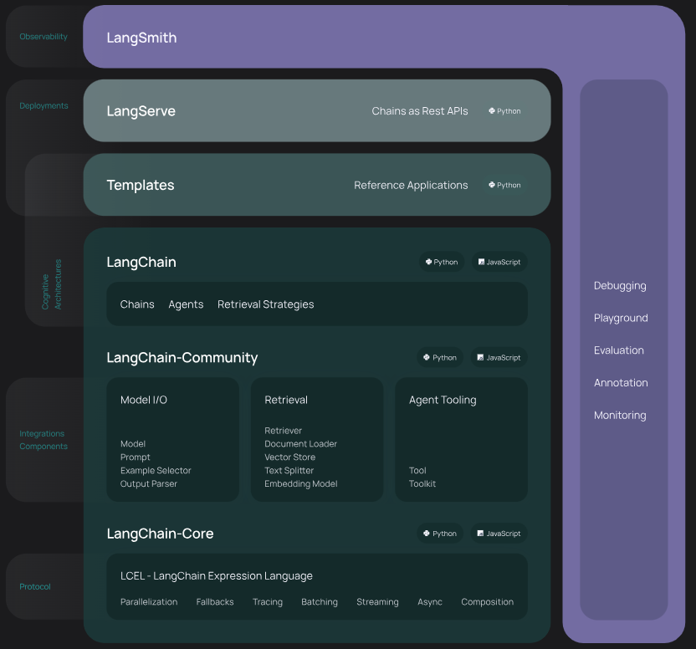
LangChain Ecosystem
Libraries (Python & JavaScript): Building blocks for creating chains and agents.
Templates: Ready-to-use architectures for various tasks (chatbots, analytics, etc.).
LangServe: Deploy chains as REST APIs for easy web service creation.

Slide 26
LangChain Ecosystem
LangSmith: Developer platform for debugging, testing, and monitoring LangChain applications.
Streamlined Development: From concept to deployment, LangChain provides tools for every stage of application development.
Image taken from :
https://python.langchain.com/v0.1/docs/get_started/introduction

Slide 27
Advantages of LangChain
Simplicity: Easy-to-use components and templates.
Flexibility: Adaptable to diverse use cases.
Scalability: Deployable as APIs for broad accessibility.
Control: Comprehensive monitoring and improvement tools.
Community : A vibrant developer community

Slide 28
Components in LangChain
There are 3 major components in LangChain
Model I/O
Retrieval
Composition
For more information about LangChain Components , please refer to this link.

Slide 29
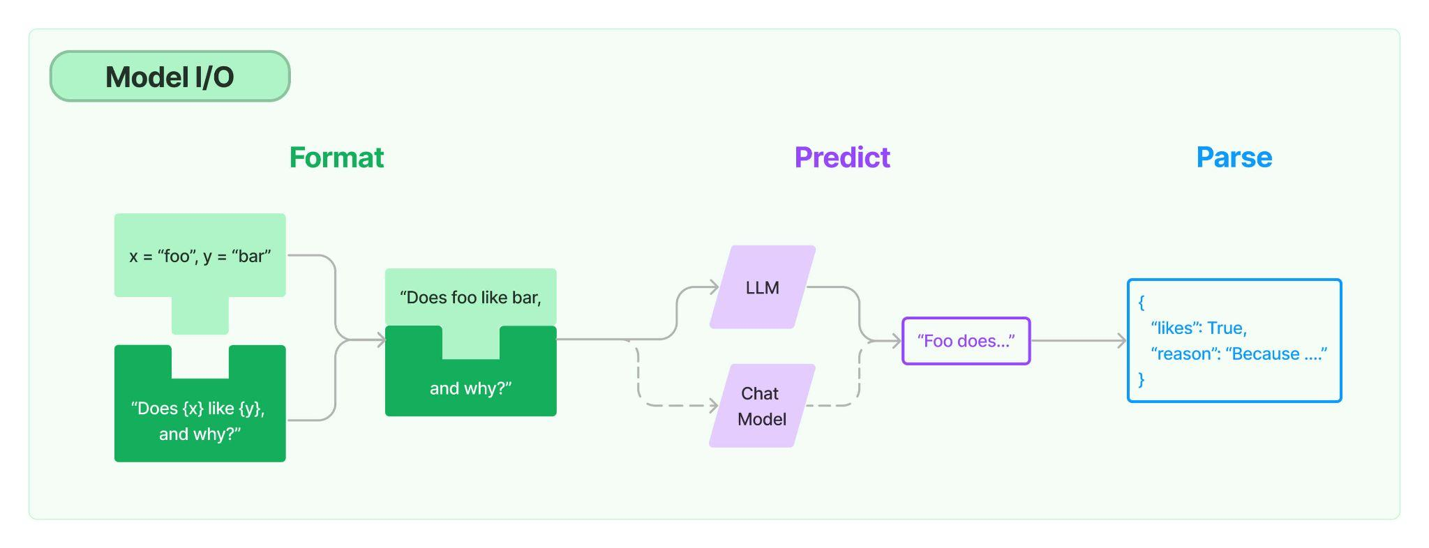
MODEL I/O

Slide 30
MODEL I/O
The major components of Model I/O are
Large Language Models (LLM) : Access LLMs present in the market with API keys
Prompt, Prompt Templates : Input to the model. Prompt template helps to format the input to the LLM.
Output Parser : Transforms the output/ response generated by the LLM into a suitable format.

Slide 31
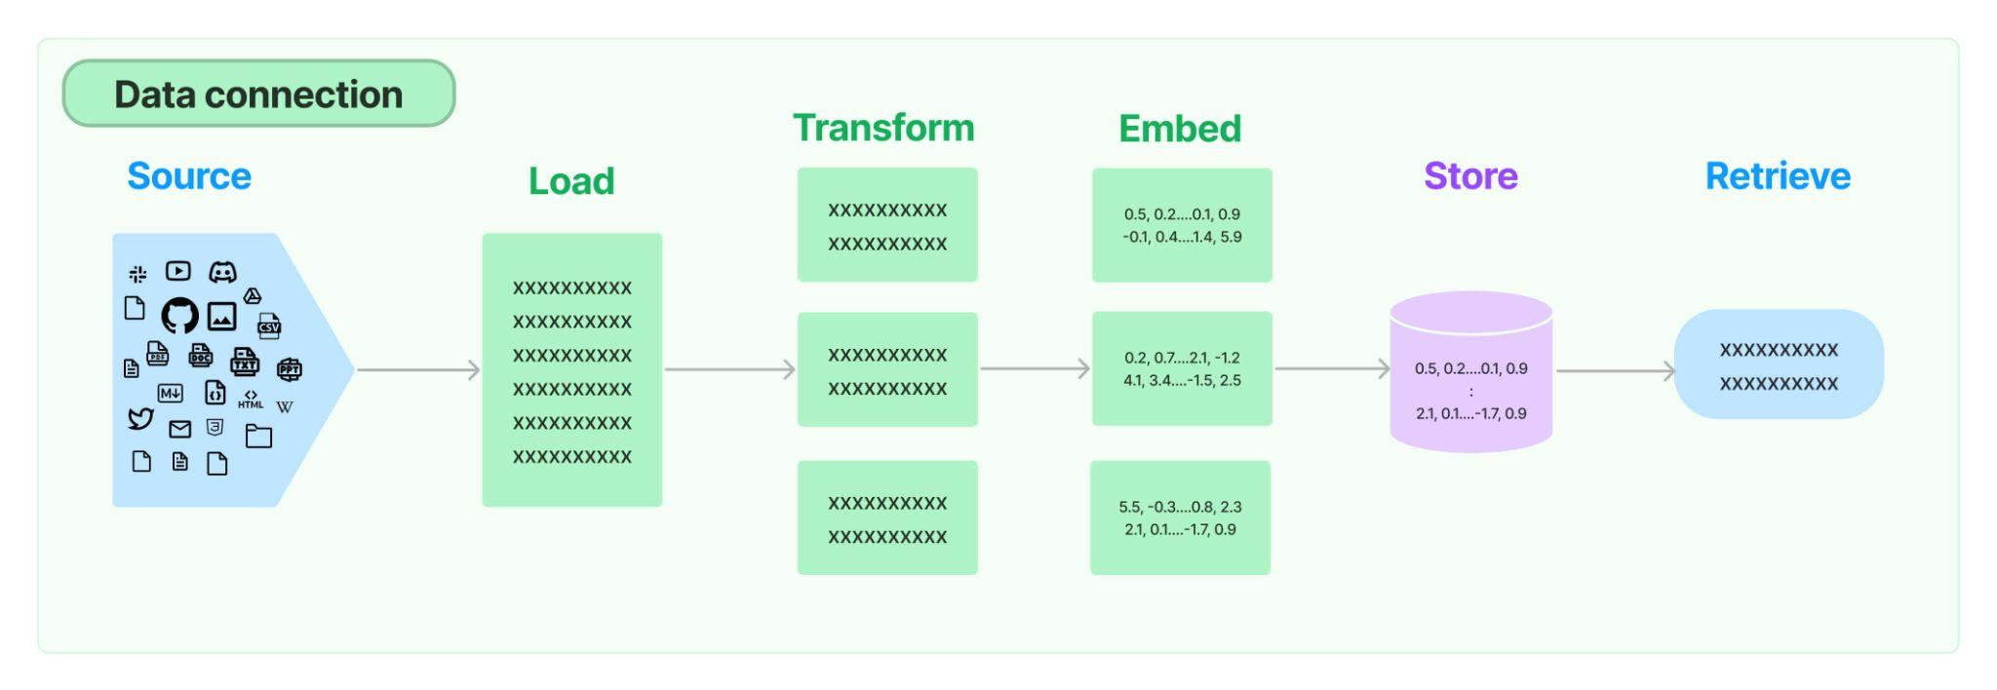
Retrieval

Slide 32
Retrieval
The major components of Retrieval are
Document Loader : Load PDF, CSV, JSON, etc., documents.
Text Splitting : Helps split lengthy documents into several small parts.
Text Embedding Model : Converts the content of a document into a vector
Vector Stores : Stores the converted vector in a database

Slide 33
Retrieval
Retrievers : This helps to retrieve content from the vector Stores based on input query
Indexing : Streamlines the process of loading and synchronizing documents from various sources into a vector store, optimizing efficiency by preventing duplication, unnecessary rewriting, and recomputation of embeddings, thus enhancing vector search outcomes even for transformed documents.

Slide 34
Composition
Composition consists of high level components such as
Chain : Chains several LangChain components to build an application
Agent : Agent involves employing a language model to select a series of actions. Unlike chains where actions are pre-programmed in code, agents utilize a language model as a decision-making tool to ascertain the actions to undertake and their sequence.
Tools : Tools are interfaces for agents, chains, or language models to interact with the world, comprising names, descriptions, JSON schemas for inputs, function calls, and return specifications, aiding in building action-taking systems.

Slide 35
Part 2 : Demo

Slide 36
Demo
For Demo, we will use Google Colab.
Few Guidelines before we start the Demo
Open “Introduction to RAG Application with GEMINI and LangChain.ipynb” in Google Colaboratory.
Upload “Taj_Mahal.jpeg” and “attentionis_all_you_need_paper.pdf” to path “/content/sample_data/”.
Follow along with me. Please Do not hesitate to ask questions!

Slide 37
Q & A
Thank you very much!

